Slide 1
Slaviša Đurđić
US Crime
Goal: Analysis of the US crime dataset for period 2015-2016 and compare it with London crime data.
Instructions:
- Collect data from the “US_crime_original.xls” file and transform it into a usable form.
- Use SQL queries to load the data to MySQL table(s).
- Execute some basic SQL queries to get first insights about the data.
- Build visuals in Power BI Desktop.
- Run regression analysis in Python.
Belgrade, August 2023

Slide 2
MySQL queries
USE data_analysis;
CREATE TABLE US_crime (
area VARCHAR(255),
event_year VARCHAR(50),
population DECIMAL,
violent_crime DECIMAL,
murder_and_nonnegligent_manslaughte DECIMAL,
rape_revised_definition DECIMAL,
rape_legacy_definition DECIMAL,
robbery DECIMAL,
aggravated_assault DECIMAL,
property_crime DECIMAL,
burglary DECIMAL,
larceny_theft DECIMAL,
motor_vehicle_theft DECIMAL
);
LOAD DATA INFILE 'C:\\ProgramData\\MySQL\\MySQL Server 8.0\\Uploads\\US_crime.csv’
INTO TABLE US_crime
FIELDS TERMINATED BY ',’
ENCLOSED BY '“’
LINES TERMINATED BY '\n’
IGNORE 1 ROWS;

Slide 3
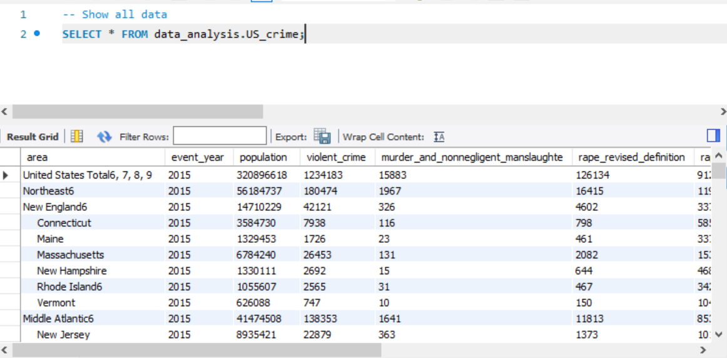
MySQL queries

Slide 4
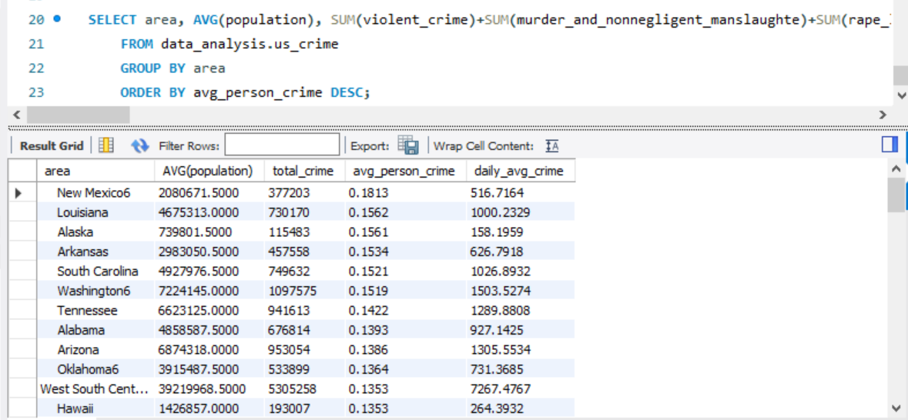
MySQL queries
New Mexico and Louisiana are top two states with respect to the number of committed crime per person:

Slide 5
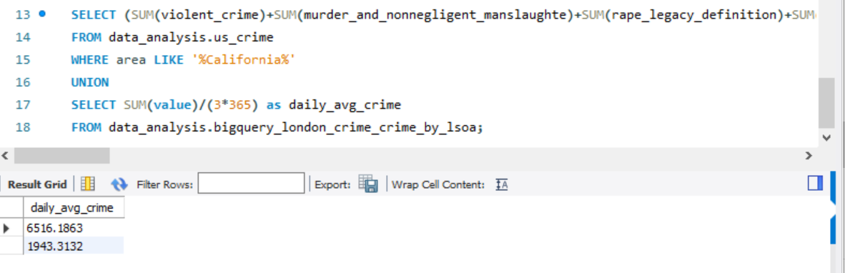
MySQL queries
Daily average crime for 2Y period for California and 3Y period 2015-2016 for London, respectively:

Slide 6

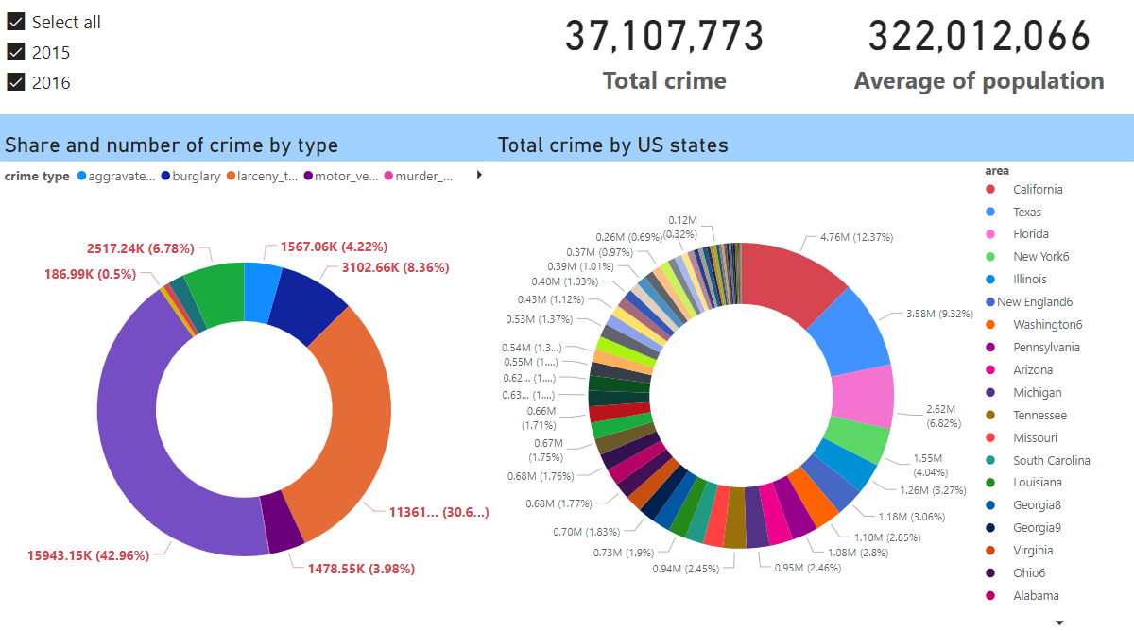
Microsoft Power BI

Slide 7
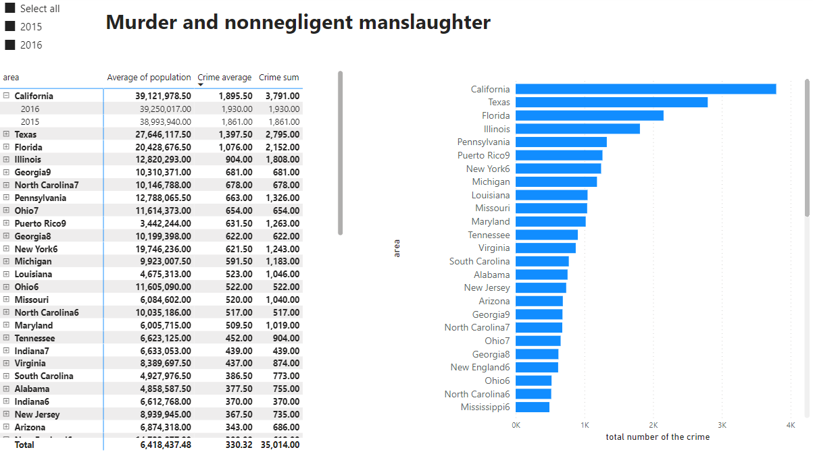
Microsoft Power BI

Slide 8
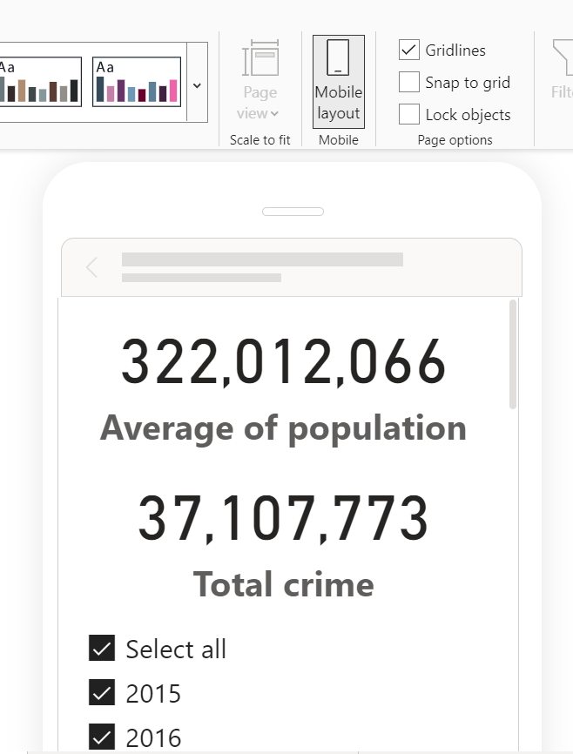
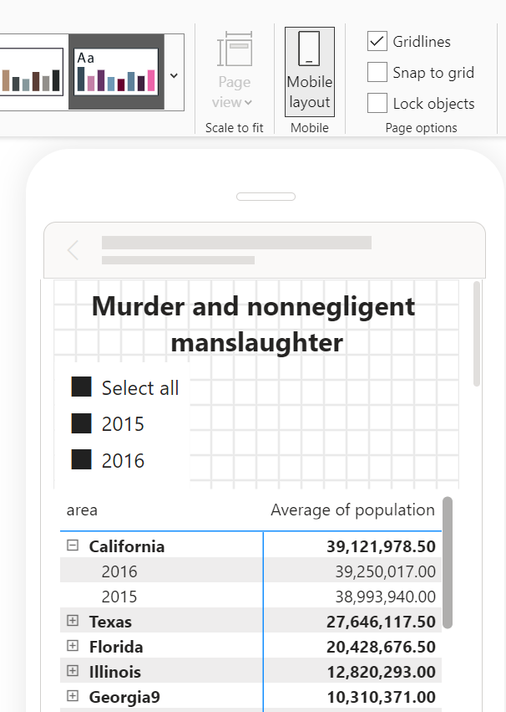
Microsoft Power BI

Slide 9
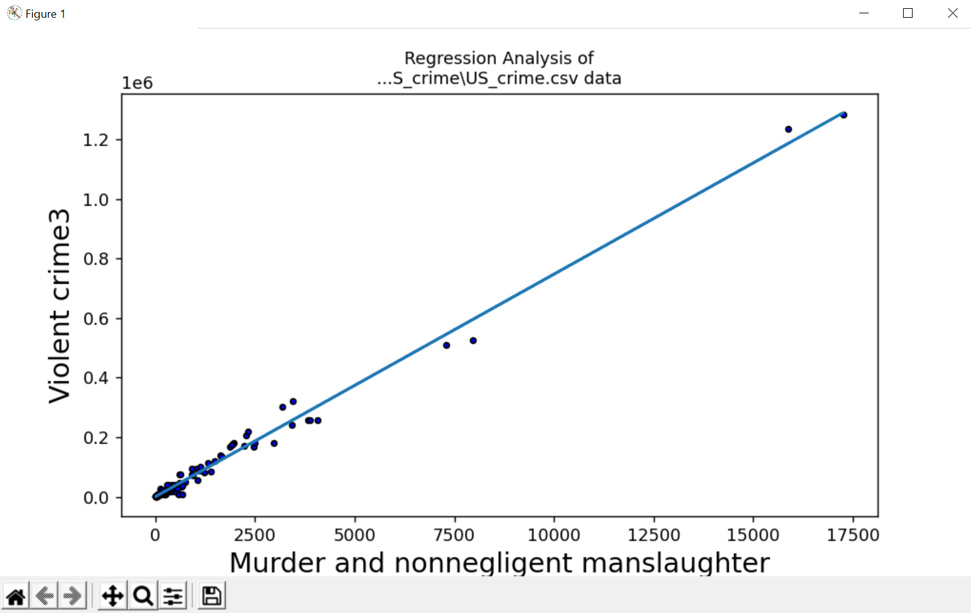
Regression Analysis in Python
R is 0.9946739411964045 R^2 is 0.9893762492951884

Slide 10
US Crime Project Insights
1) Overall, crime situation remained the same in 2016 compared to statistics from year 2015.
2) Almost 74% of crime fall under “property crime” and “larceny theft”.
3) California, Texas, and Florida were the US states with the most criminal activities reported in the given period.
4) New Mexico, Louisiana, Alaska, Arkansas, and South Carolina on the other hand had the highest number of crime committed per person.
5) California appears to be a less dangerous place than London, as its daily average of crime was ~6500 for about 40MM of people, while London's daily average of crime was ~2000 for about 9MM of people.

